Slide 1


Introduction to Amazon User Review Analysis Using NLP
Dive into the power of natural language processing to unlock insights from millions of Amazon customer reviews. Explore how this data-driven approach can help you better understand product performance, customer sentiment, and market trends.

Slide 2

Overview of Natural Language Processing (NLP)
Understanding Language
Extracting Insights
Powering AI Applications

Slide 3
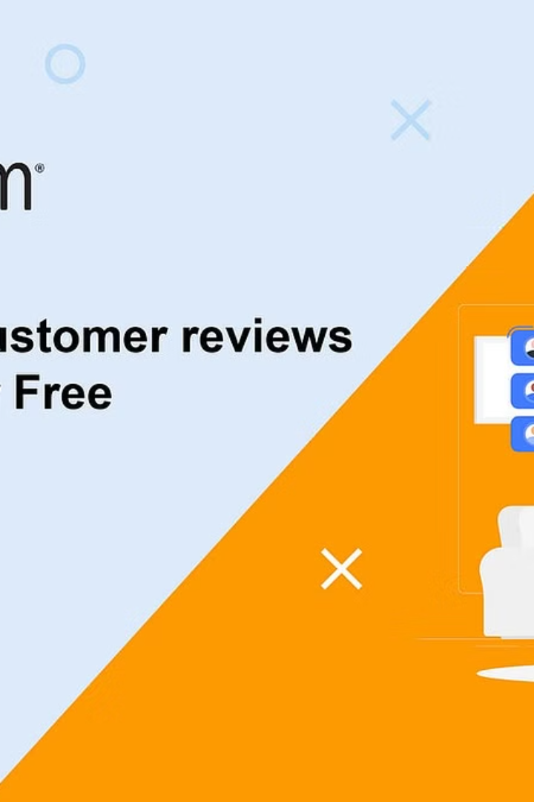

Data Collection: Extracting Amazon Reviews
The first step in our Amazon user review analysis is to collect the necessary data. We'll use web scraping techniques to extract product reviews directly from the Amazon website, ensuring we have a comprehensive dataset to analyze.
By automating the review extraction process, we can efficiently gather large volumes of user feedback across multiple product categories and brands.

Slide 4
Data Preprocessing: Cleaning and Tokenization
Text Cleaning: Removing noise, HTML tags, URLs, and other non-essential elements from the review text.
Tokenization: Splitting the cleaned text into individual words, phrases, or other meaningful units.
Stop word Removal: Eliminating common words like "the", "a", and "is" that don't carry significant meaning.

Slide 5
Sentiment Analysis: Identifying Positive and Negative Reviews
Positive Sentiment
Negative Sentiment
Sentiment Scoring

Slide 6
Topic Modeling: Discovering Dominant Themes
Corpus Preparation
Latent Dirichlet Allocation
Thematic Extraction

Slide 7
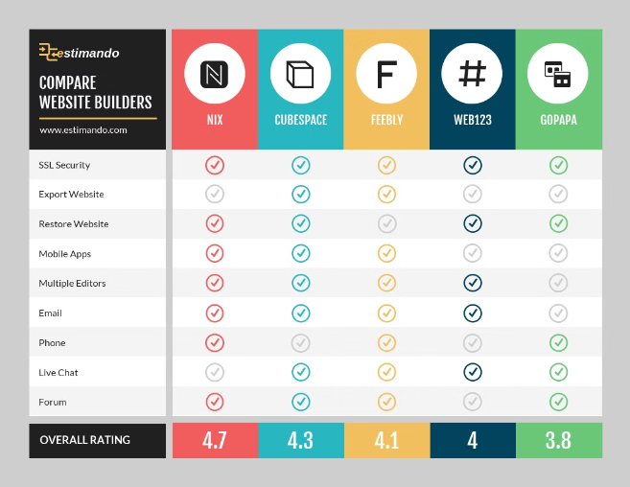
Aspect-Based Sentiment Analysis: Evaluating Product Features

Slide 8
Comparative Analysis: Benchmarking Competitors
Market Share
Product Features
Customer Satisfaction
Pricing Strategies

Slide 9
Insights and Recommendations
Actionable Insights
Personalized Recommendations
Competitive Benchmarking

Slide 10


Conclusion and Future Directions
In conclusion, our Amazon user review analysis using natural language processing has yielded valuable insights that can drive strategic decisions. The depth of customer sentiment, dominant themes, and comparative analysis of competitors provide a robust foundation for product improvements and marketing strategies.
Looking ahead, we envision expanding this analysis to encompass a broader range of product categories and incorporating additional data sources, such as social media conversations, to further refine our understanding of customer preferences and pain points. Exploring advanced NLP techniques like aspect-based sentiment analysis and neural network models can unlock even more granular insights to stay ahead of the competition.

Slide 11
Any Queries?

Slide 12
THANK YOU!

